Slide 1


SMART INDIA HACKATHON 2024
TITLE PAGE
Problem Statement ID – SIH1584
Problem Statement Title- Al based acoustic wave monitoring of rail defects like cracks, fracture and prediction for rail wear, quality along with other parameter.
Theme- Transportation & Logistics
PS Category- Hardware
Team ID-
Team Name (Registered on portal)

Slide 2
IDEA TITLE
Your Team Name
Proposed Solution (Describe your Idea/Solution/Prototype)
Detailed Solution: An autonomous robotic vehicle equipped with high-frequency acoustic sensors performs systematic inspections of railway tracks, identifying critical defects like rail head transverse fractures. The collected data is processed using AI-powered cloud-based analytics for real-time defect prediction and automated maintenance alerts.
Problem Addressed: Enhances railway safety by overcoming limitations of conventional methods, ensuring early detection of hidden defects. The system's scalable, modular architecture and environmental adaptability provide optimized maintenance interventions, reducing accident risks and improving resource allocation.
Innovation & Uniqueness: Integrates autonomous robotics, acoustic signal processing, and AI-driven predictive analytics into a high-efficiency, real-time monitoring system. This data-centric approach ensures proactive maintenance, advancing the field of railway safety with cutting-edge technology.

Slide 3
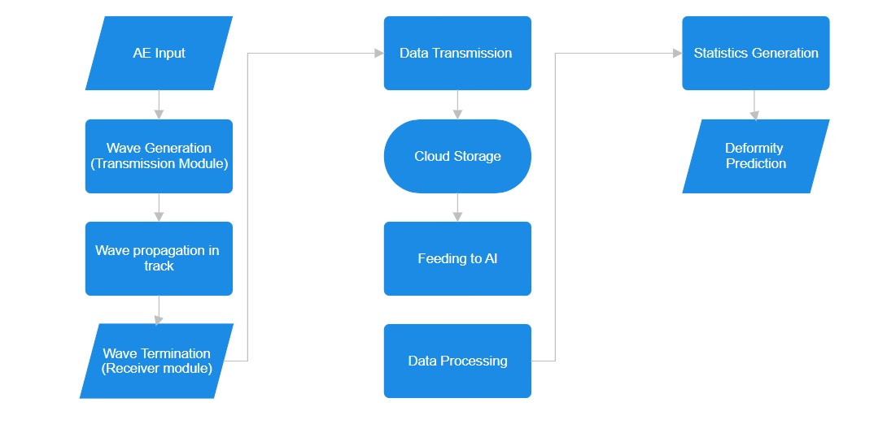
TECHNICAL APPROACH
Your Team Name
Technologies Used:
Hardware: Autonomous bot with EMATs for acoustic wave generation, microcontroller (ESP32), and cloud platform (AWS/Azure).
Software: Python for AI models, TensorFlow/PyTorch for predictive analysis, IoT protocols (MQTT/HTTP) for data communication.
Implementation Process:
Bot Operation: Autonomous navigation, acoustic signal emission (EMAT), and defect detection.
Data Workflow: Signal capture, transmission to cloud, preprocessing, AI analysis, and alert generation.

Slide 4
FEASIBILITY AND VIABILITY
Your Team Name
Feasibility Analysis:
Environmental Adaptability: Operates efficiently in extreme climates (heat, cold, humidity); tested in regions like Rajasthan and Kerala.
Operational Reliability: AI targets >95% accuracy, improving on 82.96% with built-in self-diagnostics for minimal manual intervention.
Scalability Potential: Modular design allows for phased expansion across the national railway network.
Potential Challenges:
Technical: Ensuring hardware reliability and achieving high detection accuracy.
Operational: Managing large-scale deployment and maintenance.
Environmental: Performance under extreme weather conditions.
Strategies for Overcoming Challenges:
Technical: Extensive testing; continuous AI model optimization.
Operational: Phased deployment; robust maintenance support.
Environmental: Weather-resistant hardware design.

Slide 5
IMPACT AND BENEFITS
Your Team Name
Potential Impact & Benefits
Potential Impact on the Target Audience:
Passengers: Enhanced safety and reliability of train services, reducing the risk of accidents and improving travel comfort.
Railway Operators: More efficient maintenance operations, minimizing service interruptions and optimizing resource allocation.
Benefits of the Solution:
Social:
Safety: Reduces risk of derailments and accidents, ensuring safer journeys for millions of passengers.
Reliability: Improves overall service reliability, leading to increased passenger satisfaction.
Economic:
Cost Savings: Lowers maintenance and repair costs through early detection and targeted interventions.
Growth: Supports economic growth by ensuring the smooth operation of the railway network, boosting ridership.
Environmental:
Sustainability: Prevents major failures that could result in significant environmental damage, contributing to the long-term sustainability of the rail network.

Slide 6
RESEARCH AND REFERENCES
Your Team Name
https://www.mdpi.com/2076-3417/11/3/1071

Slide 7
IMPORTANT INSTRUCTIONS
Please ensure below pointers are met while submitting the Idea PPT:
Kindly keep the maximum slides limit up to six (6). ( Including the title slide)
Try to avoid paragraphs and post your idea in points /diagrams / Infographics /pictures
Keep your explanation precise and easy to understand
Idea should be unique and novel.
You can only use provided template for making the PPT without changing the idea details pointers (mentioned in previous slides).
You need to save the file in PDF and upload the same on portal. No PPT, Word Doc or any other format will be supported.
Note - You can delete this slide (Important Pointers) when you upload the details of your idea on SIH portal.

